Slide 1
MULTI-CUT REBAR(13)
Advisor : Prof. K.C.Chang
Presenters : You-Ran Nai
Notes:
試試看暫停一下

Slide 2
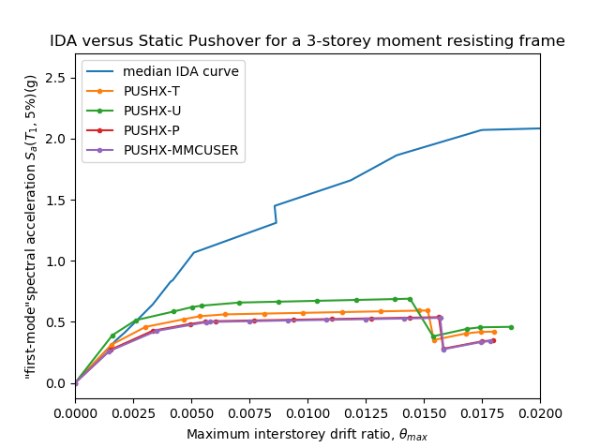
Pushover and IDA too much difference

Slide 3
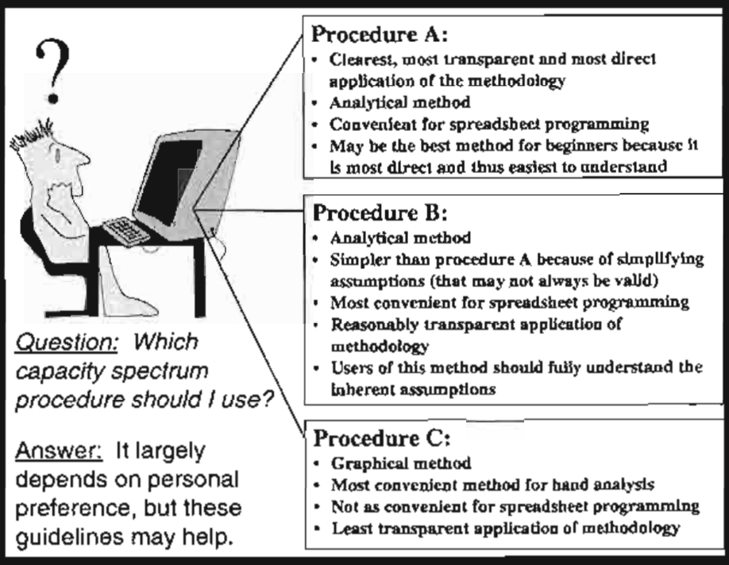

Need to determine $C_{A}, C_{V}, SR_{A}, SR_{V}$
Have simplifying assumptions
Convenient for hand analysis

Slide 4
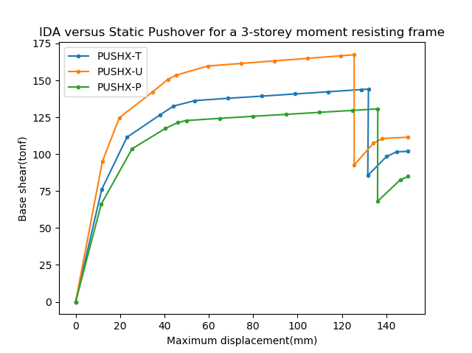
Capacity Curve
load pattern: triangle, uniform, power
Demand curve
TAP010 scaled factor: 0.5:0.5:10

Slide 5
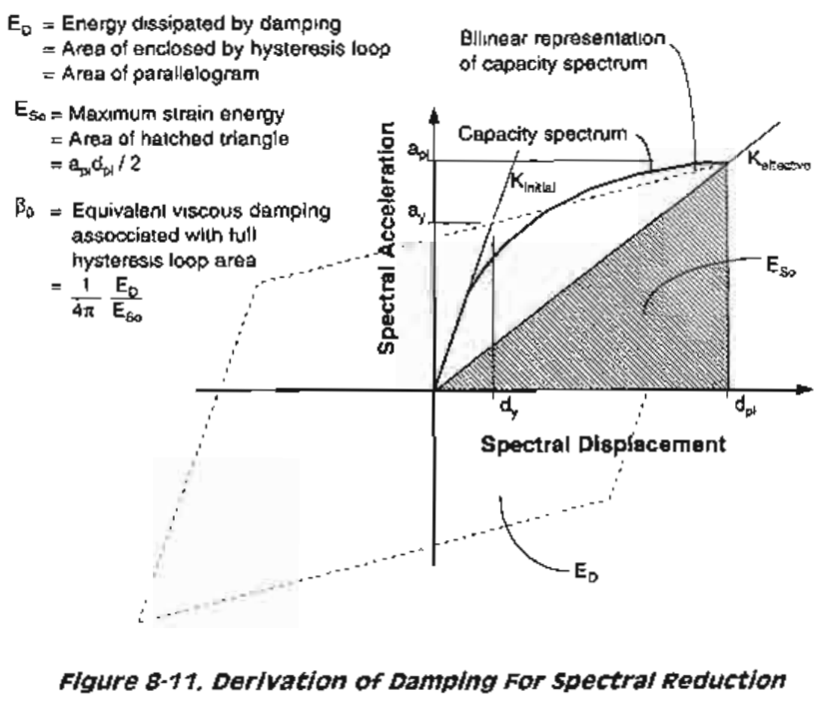
Procedure B
( d*, a* )
(dy, ay )
dpi, Beff
Performance point

Slide 6
SF: 0.5
SF: 2.5
SF: 4.5
SF: 6.5
SF: 8.5
SF: 10

Slide 7
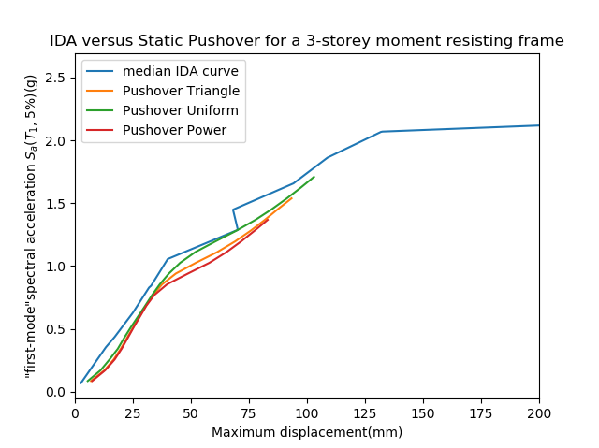
Result

Slide 8
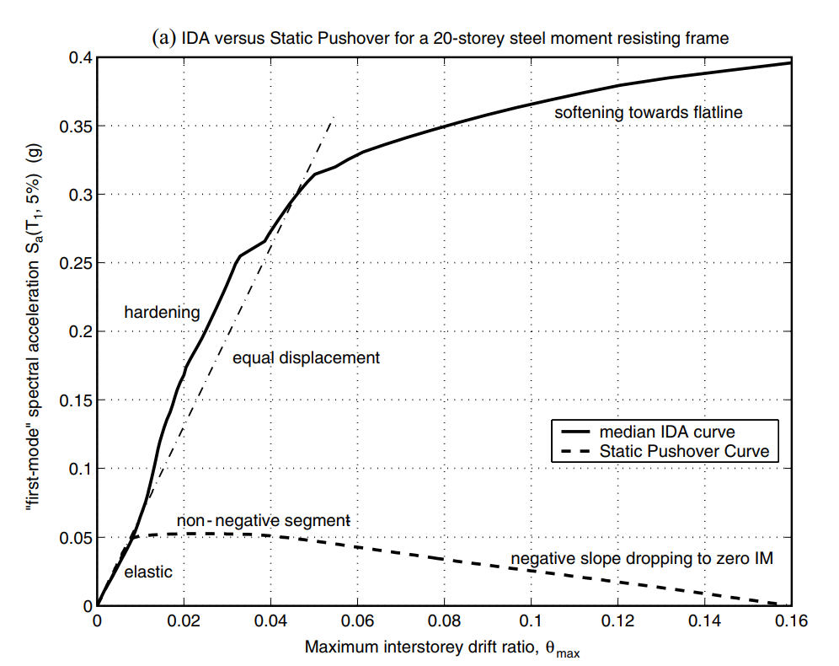
NON-LINEAR SPO
ELASTIC
➔
MATCH
NON-NEGATIVE
➔
EQUAL DISPLACEMENT
NEGATIVE
➔
SOFTENING

Slide 9
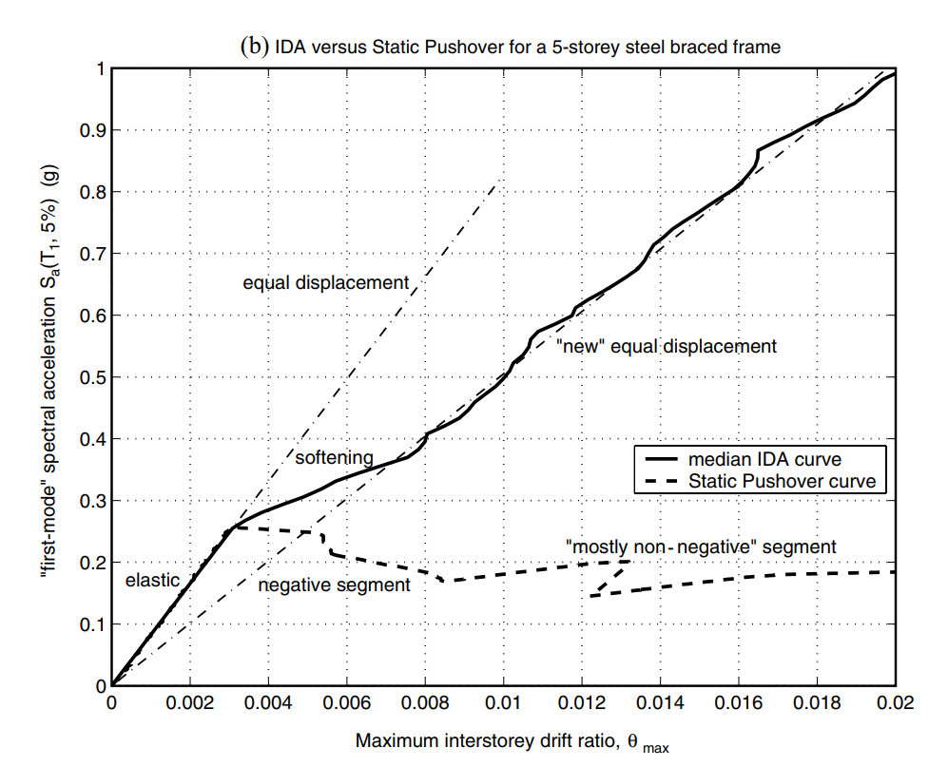
NON-LINEAR SPO
NEGATIVE => NON-NEGATIVE
NEW
EQUAL DISPLACEMENT
➔

Slide 10
FEMA 273
Linear Static Procedure (LSP)
Linear Dynamic Procedure (LDP)
Nonlinear Static Procedure (NSP)
Nonlinear Dynamic Procedure (NDP)

Slide 11
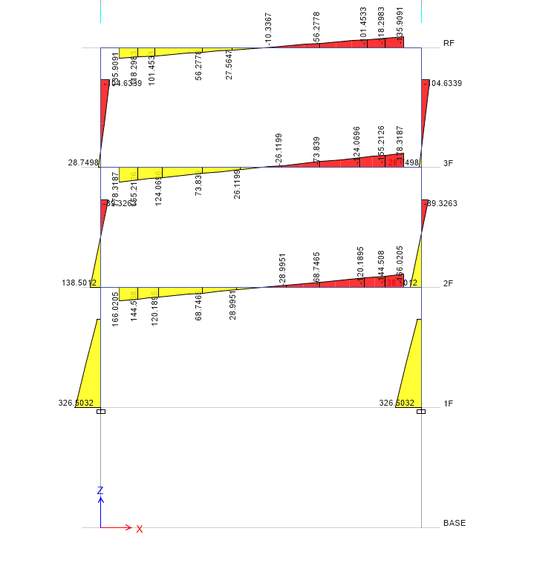
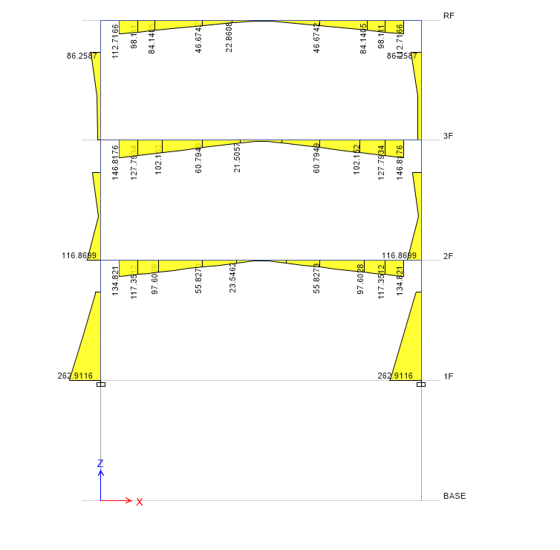
LSP: Design Base Earthquake
LDP: Design Base Earthquake

Slide 12

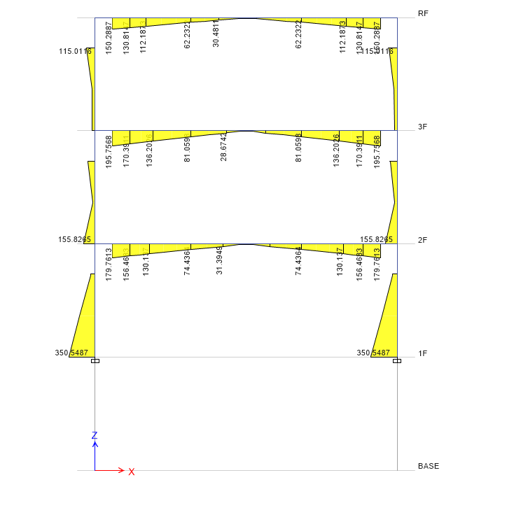
LSP: Maximum Consider Earthquake
LDP: Maximum Consider Earthquake

Slide 13
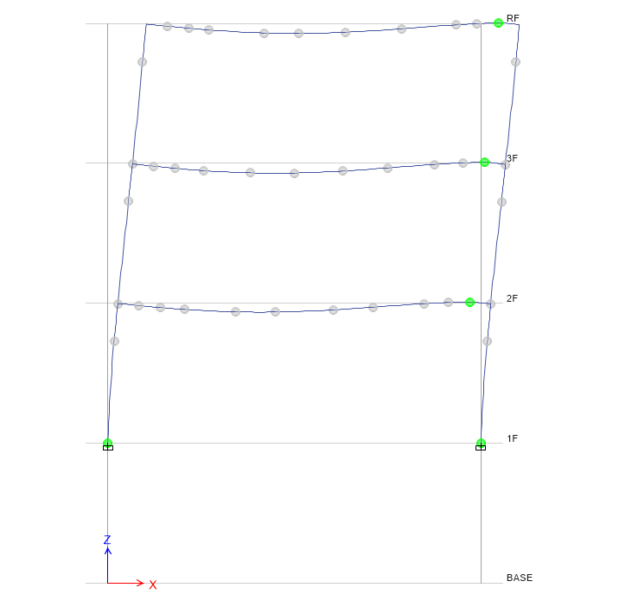
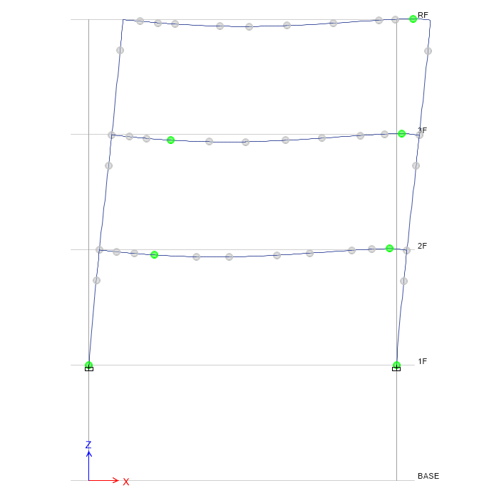
Nonlinear Static Procedure
Design
Maximum

Slide 14
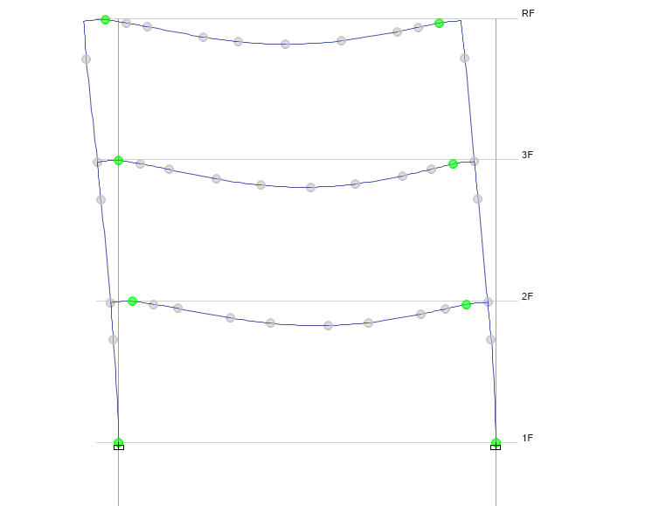
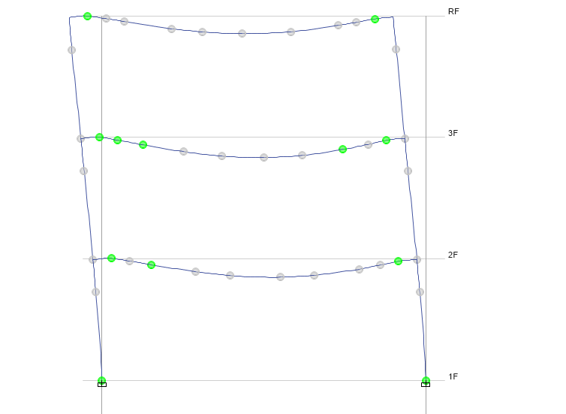
Nonlinear Dynamic Procedure
Design
Maximum

Slide 15
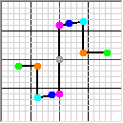

Slide 16
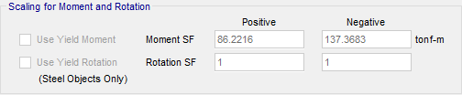

Slide 17
FEMA P695
Select structure and design spectrum
Time history records
CMR, ACMR

Slide 18
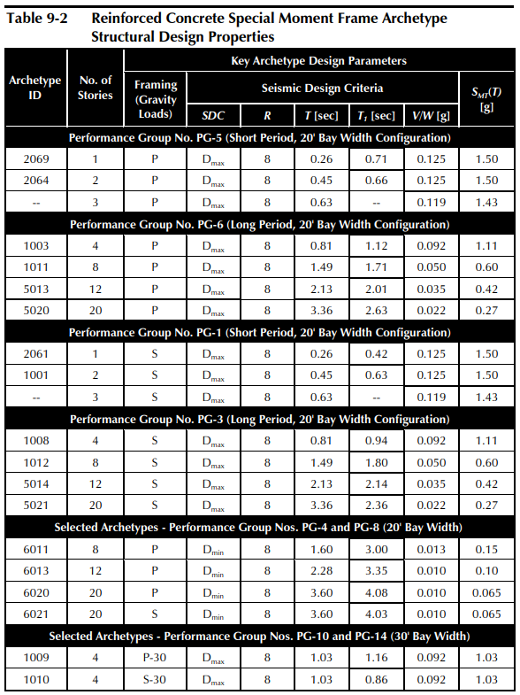
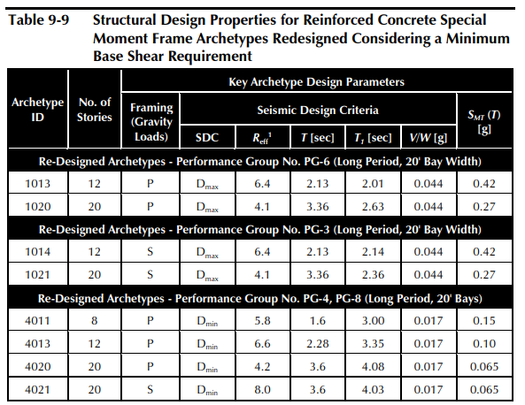

Slide 19
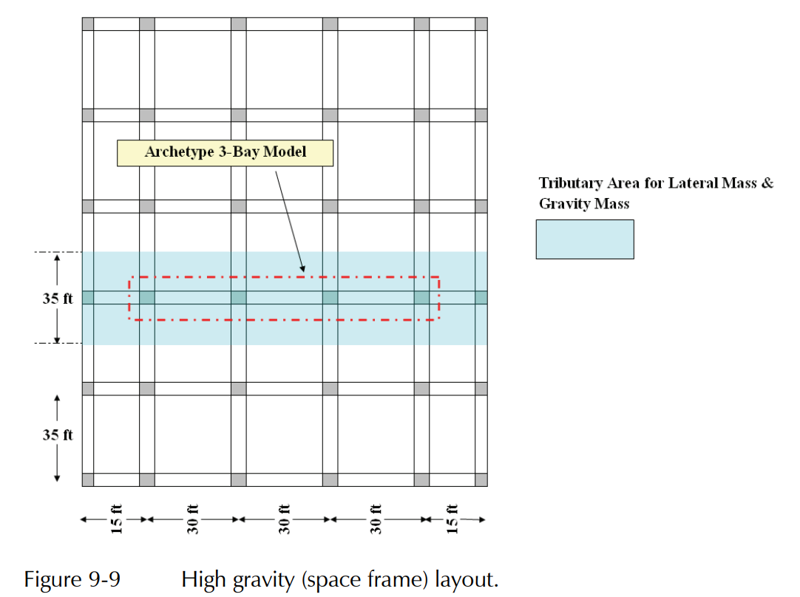
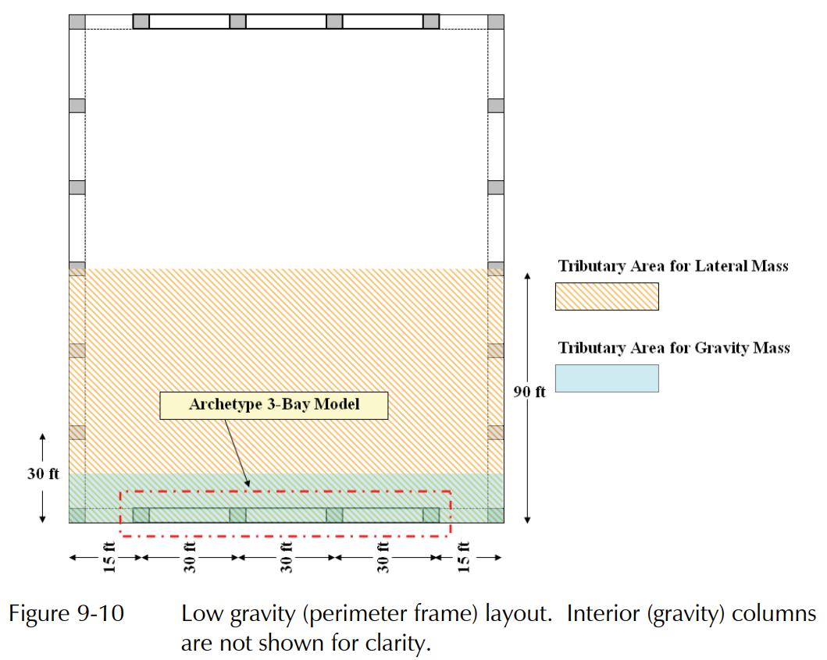
Space frame
Perimeter frame

Slide 21
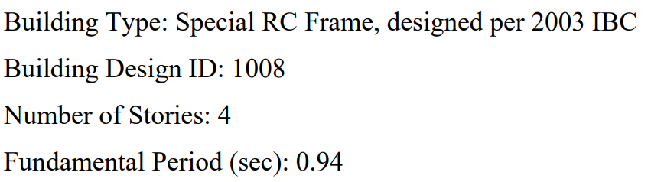
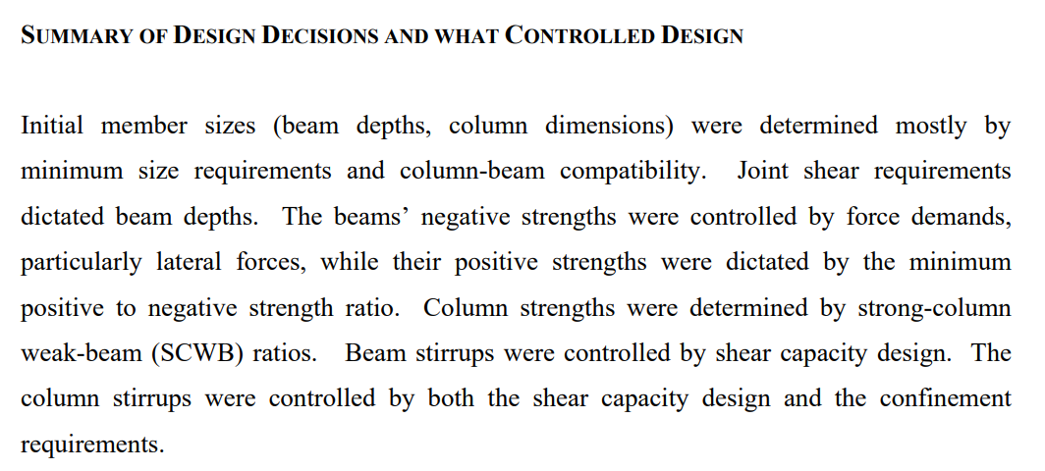

Slide 22
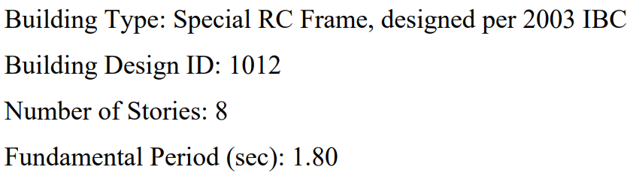
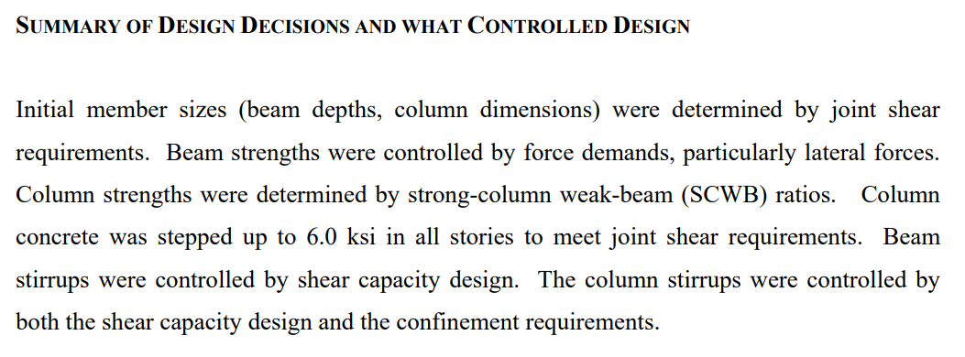

Slide 23
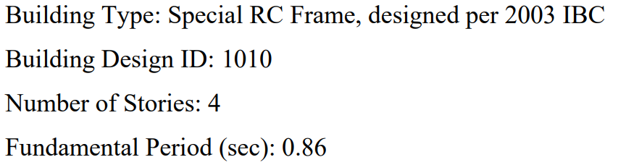
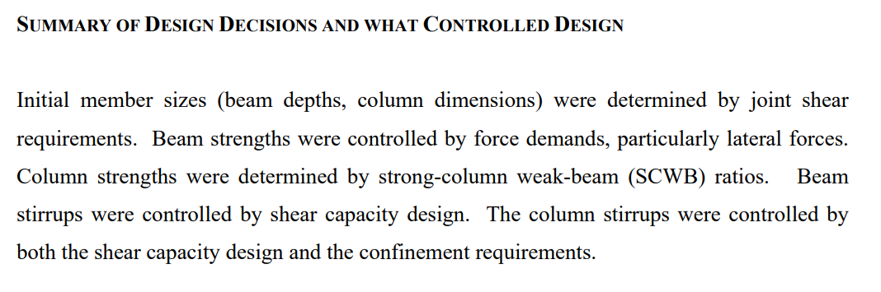

Slide 24
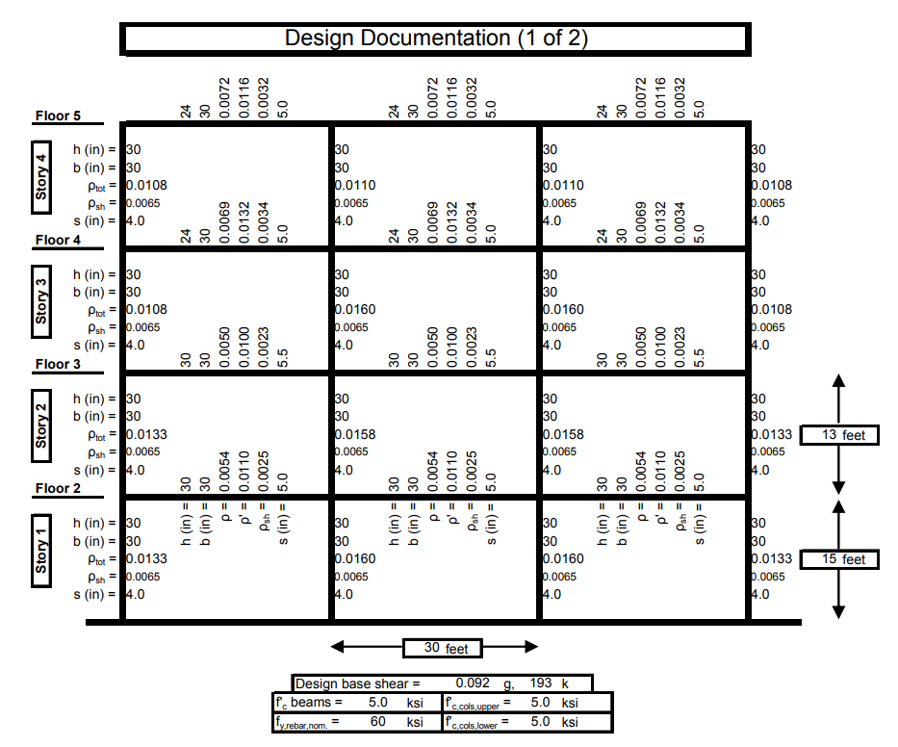

Slide 25
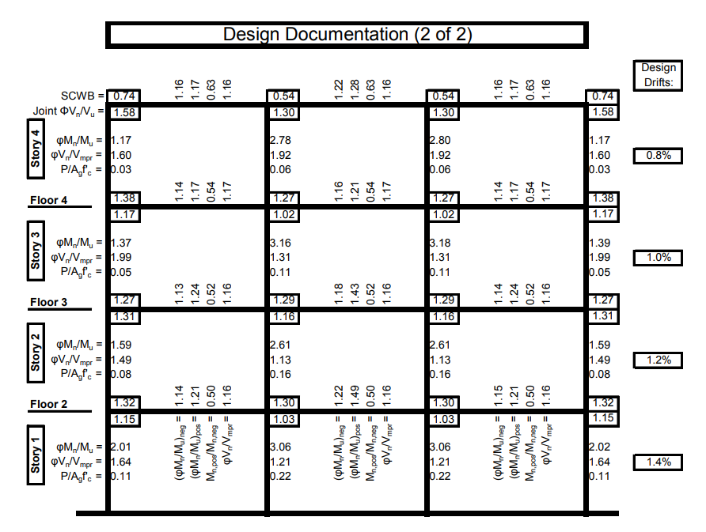

Slide 26
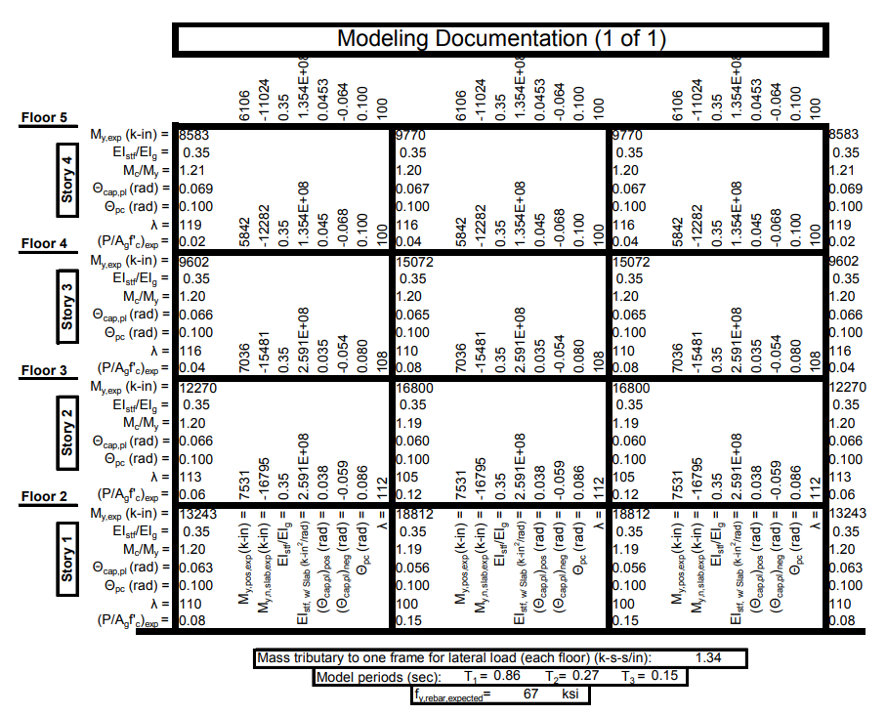

Slide 27
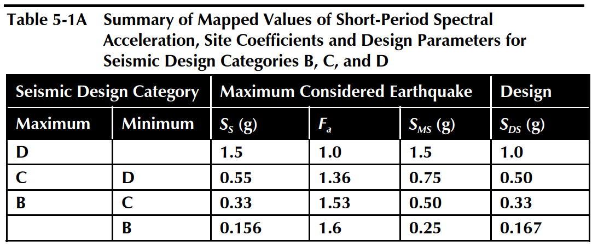
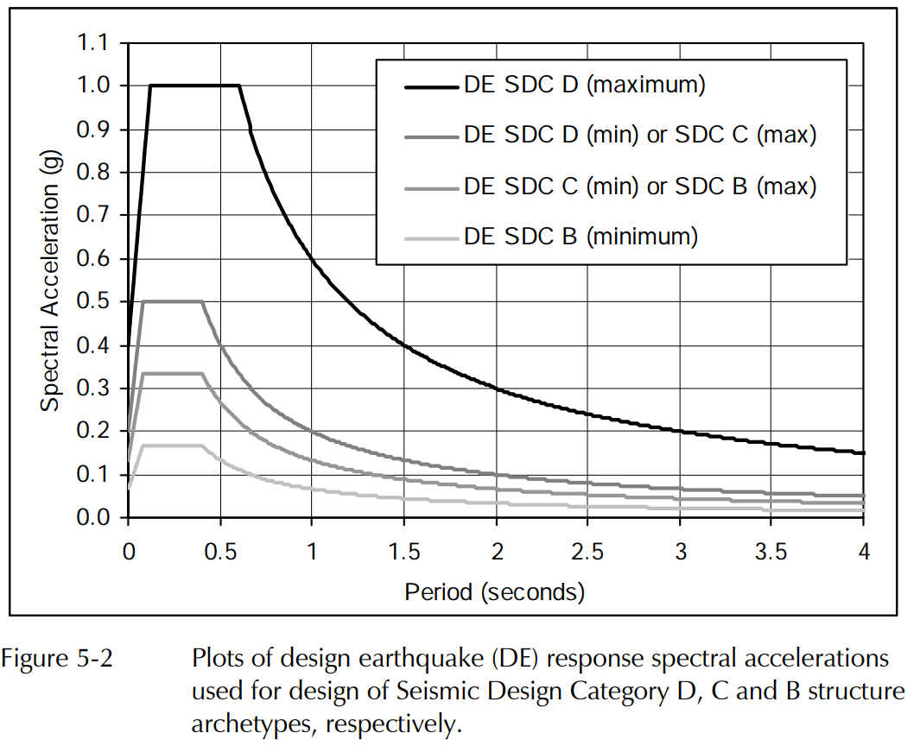
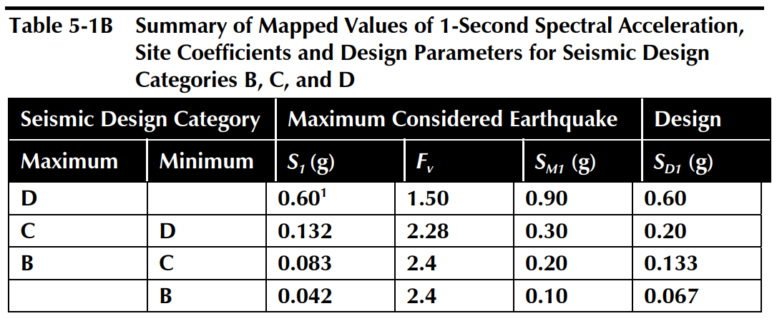

Slide 28
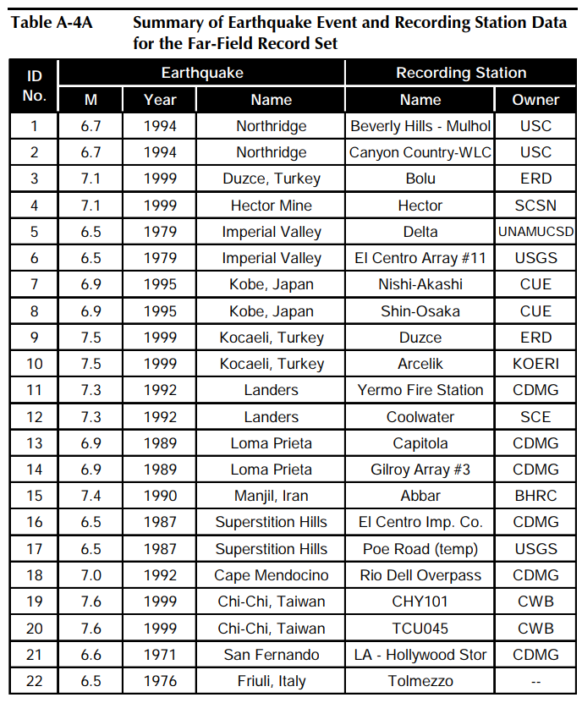
Time history records

Slide 29
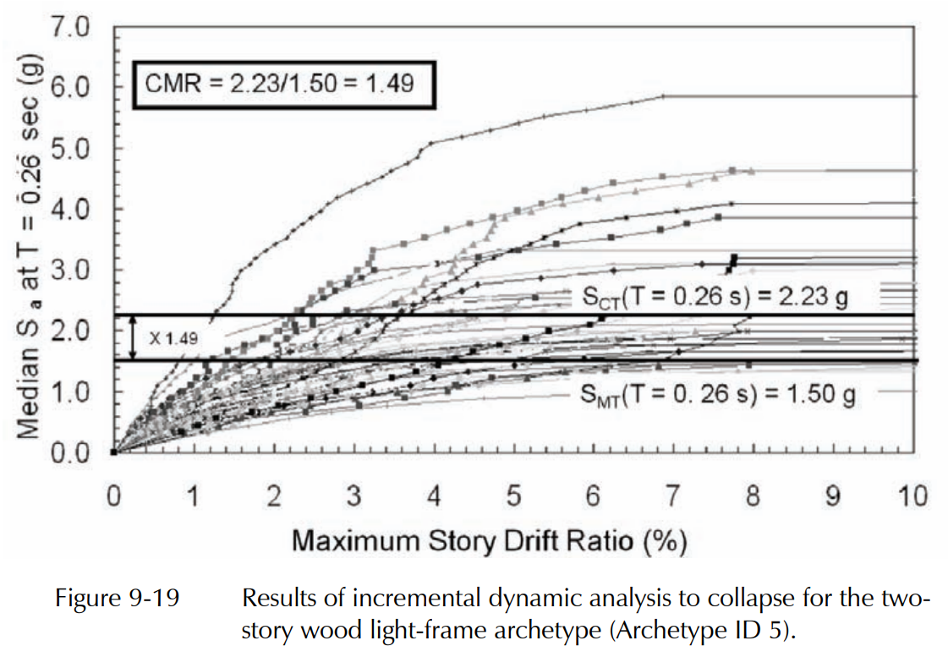
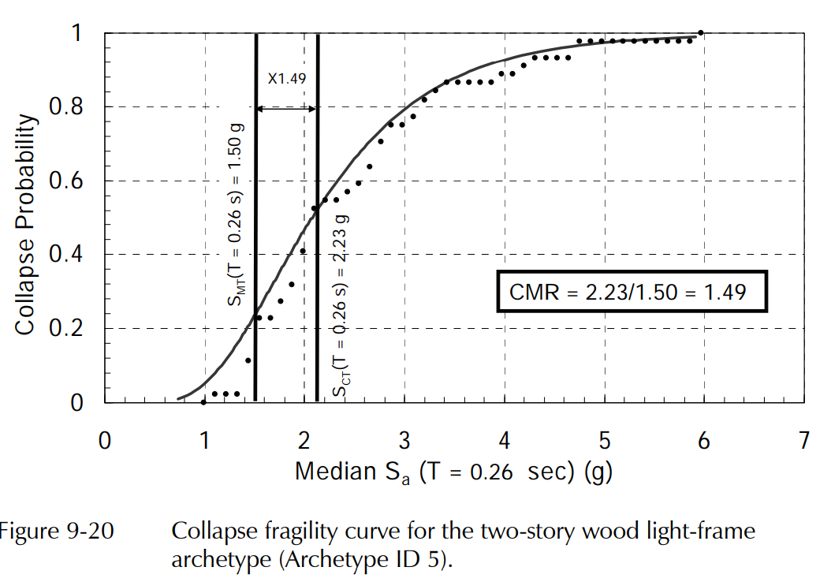
CMR

Slide 30
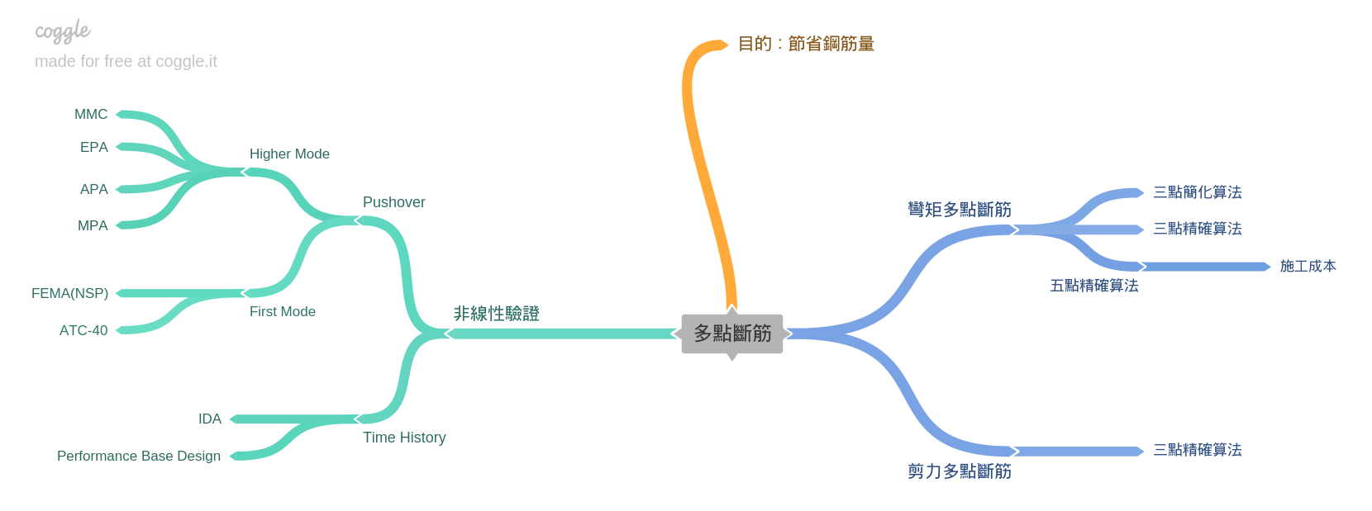
Roadmap
Nonlinear Hinge

Slide 31
Roadmap
Nonlinear Hinge Program: To Use In Complex Structure
Simulate Model: FEMA P695 Model? ➔ Actual Model ( from corporation )

